Slide 1
Research and Innovation
Research Seminar
NIH Data Management and Sharing Plans – Experience So Far
Fred Prior, PhD
Professor and Chair
Department of Biomedical Informatics
Professor of Radiology
University of Arkansas for Medical Sciences

Slide 2
Learning Objectives
Communicate the main components of the NIH DMSP policy.
Illustrate the rationale behind this policy
Provide guidance for researchers on how to approach each section of a DMSP
Describe our experience thus far with this NIH requirement

Slide 3
NIH Policy for Data Management and Sharing
The DMS policy (NOT-OD-21-013) took effect January 25, 2023
https://grants.nih.gov/grants/guide/notice-files/NOT-OD-21-013.html
It applies to “all research, funded or conducted in whole or in part by NIH, that results in the generation of scientific data. This includes research funded or conducted by extramural grants, contracts, Intramural Research Projects, or other funding agreements regardless of NIH funding level or funding mechanism.”
All R, P, U grant mechanisms
Some Career Development Awards (K)
Small Business SBIR/STTR
It does not apply to:
Training (T)
Fellowships (F)
Construction (C06)
Conference Grants (R13)
Resource (G)
Research-Related Infrastructure Programs (e.g., S06)
DMSP extends the 2003 Data Sharing Policy, the 2014 Genomic Data Sharing Policy and the 2016 Clinical Trials Policy
Notes:
Considered to be grants that do not produce scientific data

Slide 4
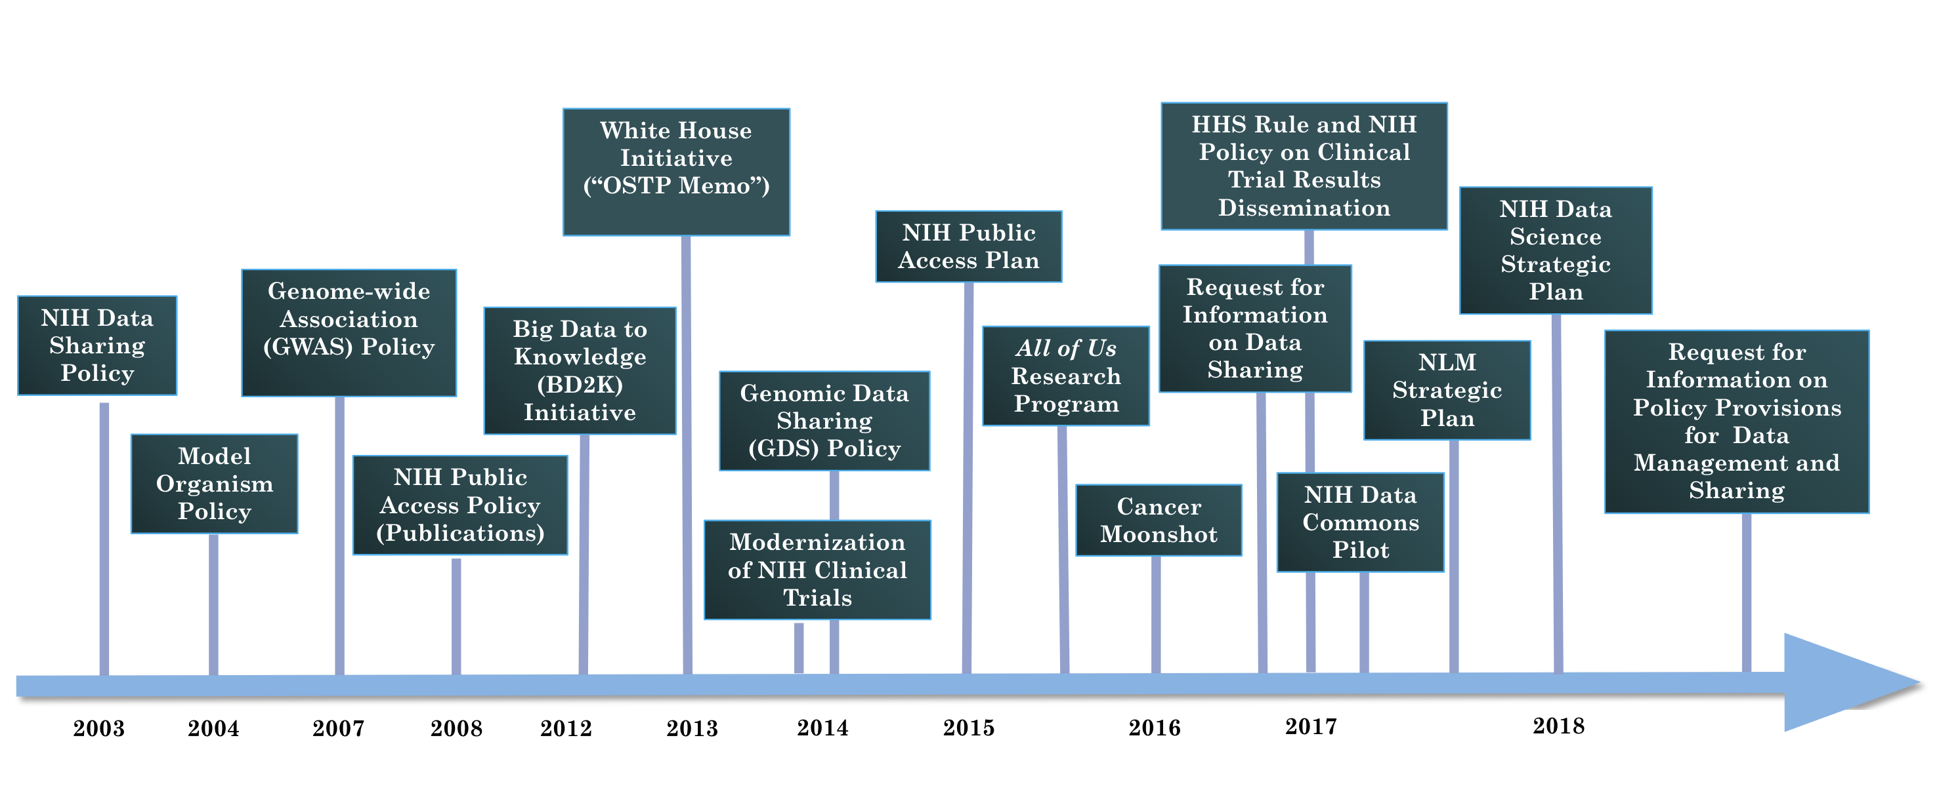
NIH’s Culture of Data Sharing

Slide 5
Data Management and Sharing Plan
“A plan describing the data management, preservation, and sharing of scientific data and accompanying metadata.”
Data Management: ”The process of validating, organizing, protecting, maintaining, and processing scientific data to ensure the accessibility, reliability, and quality of the scientific data for its users.”
Data Sharing: ”The act of making scientific data available for use by others (e.g., the larger research community, institutions, the broader public), for example, via an established repository.”

Slide 6
What counts as data for sharing?
What does not count as data for sharing?
laboratory notebooks
preliminary analyses
completed case report forms
drafts of scientific papers
plans for future research
peer reviews
communications with colleagues
physical objects, such as laboratory specimens
Adequate data to validate and replicate study findings
Data resulting from the study but not necessarily supporting a publication
Null findings that do not result in publication

Slide 7
Acceptable reasons to not share
informed consent limitations on sharing
existing consent (e.g., for previously collected biospecimens) prohibits sharing
privacy or safety of research participants would be compromised or place them at greater risk of re-identification or suffering harm
explicit federal, state, local, or Tribal law, regulation, or policy prohibits disclosure
datasets cannot practically be digitized with reasonable efforts

Slide 8
Elements of a DMSP
Description of the data plus metadata and documentation
Related tools, software, code, etc
Standards for the data/metadata
Data preservation, access, and associated timelines
https://grants.nih.gov/grants/guide/notice-files/NOT-OD-21-014.html
Access, distribution, and reuse considerations
Oversight of data management and sharing

Slide 9
https://grants.nih.gov/grants/forms/all-forms-and-formats/data-management-and-sharing-plan-format-page

Slide 10
Data Description
What metadata and documentation will be included to facilitate interpretation
The type and amount of data that will be collected or used
What data will be shared
Data modality (e.g., imaging, genomic, survey)
Level of aggregation (e.g., individual or aggregated)
Degree of data processing (e.g., raw vs processed data)
Including rationale for data that are not shared (e.g., legal or ethical considerations)
Metadata standards
Study protocols
Codebooks
Data collection instruments

Slide 11
Related tools, software, code
Standards
Specialized tools that are needed to access the shared data
Names of specific software tools (e.g., SAS, FSL, GATK, etc.)
Availability of tools (e.g., open source, commercial product)
Expected lifespan of the tools compared to length of data availability
Data formats
Data dictionaries
Common Data Elements
Identifiers
Definitions
Indicate when no consensus standard exists

Slide 12
Data preservation, access, and timelines
Access, distribution, reuse considerations
Name of repository(ies) where data will be shared
Findability and identifiability of data (e.g., unique identifiers)
When data will be shared
No later than time of publication or end of performance period
How long data is anticipated to be available
Informed consent
Privacy and confidentiality protections
Restrictions imposed by federal, Tribal, or state laws, regulations, or policies (e.g., HIPAA, FERPA)
Notes:
TCIA creates Pids for each patient and UIDs for each study, DOIs for each collection
NDA assigns GUIDs

Slide 13
Plan submission, review, and compliance
Compliance
Incorporated into Terms and Conditions
Monitored at regular reporting intervals
Compliance may factor into future funding decisions
Assessment
Peer reviewers may comment on (not score) budget
NIH program staff assess Plans
Plans can be updated
Submission
With application for funding in Budget Justification section
Notes:
DSMP in other attachments

Slide 14
Allowable costs
Data curation and development of documentation
Local data management (i.e. during the project, before submitting to a repository)
Preservation and sharing in repositories
https://grants.nih.gov/grants/guide/notice-files/NOT-OD-21-015.html

Slide 15
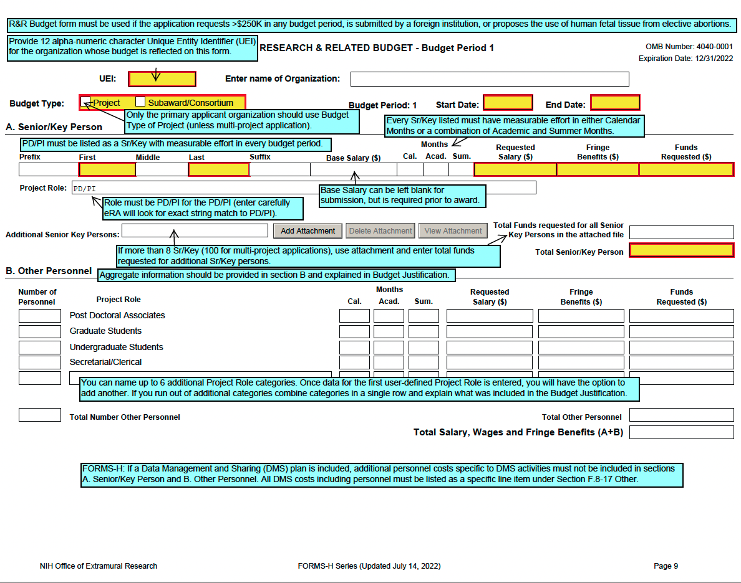

Slide 16
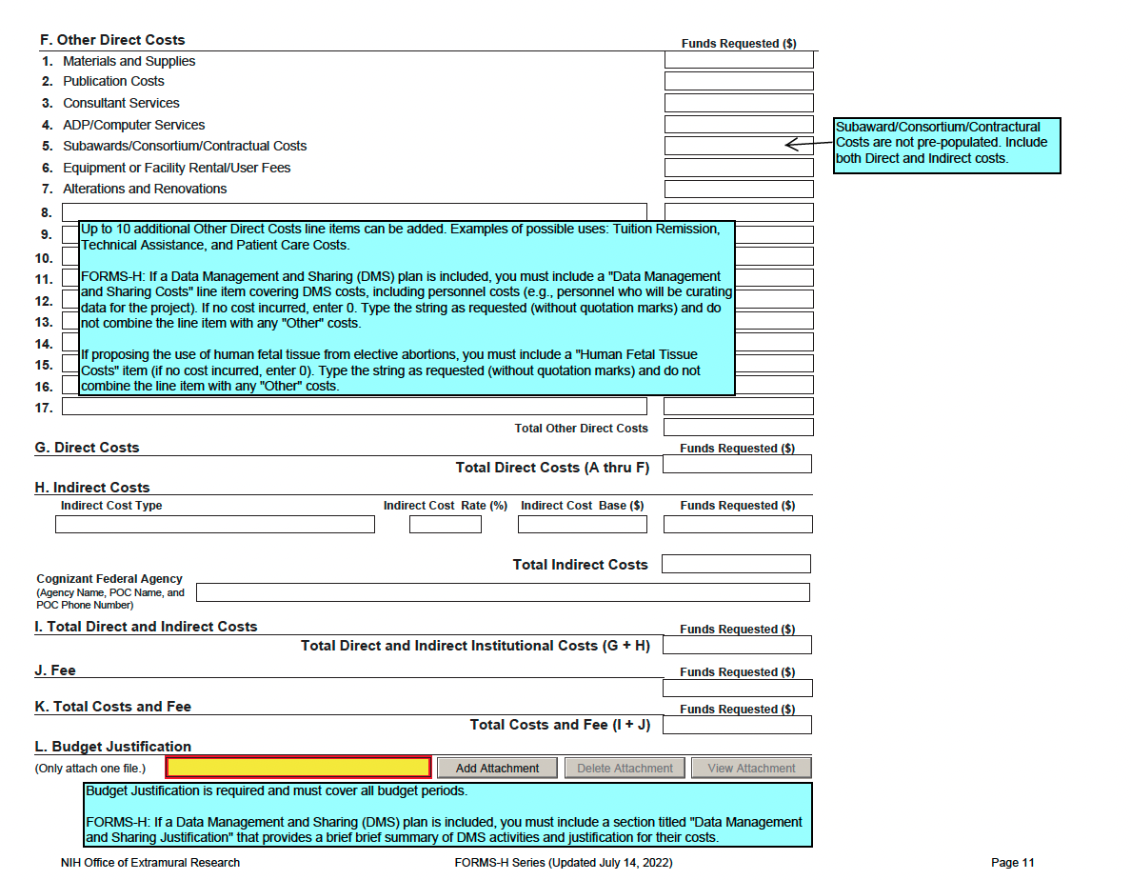
Notes:
data management and sharing justification is required on modular budgets. It is entered under the additional narrative justification. Even if the cost is zero, we must enter a file.

Slide 17
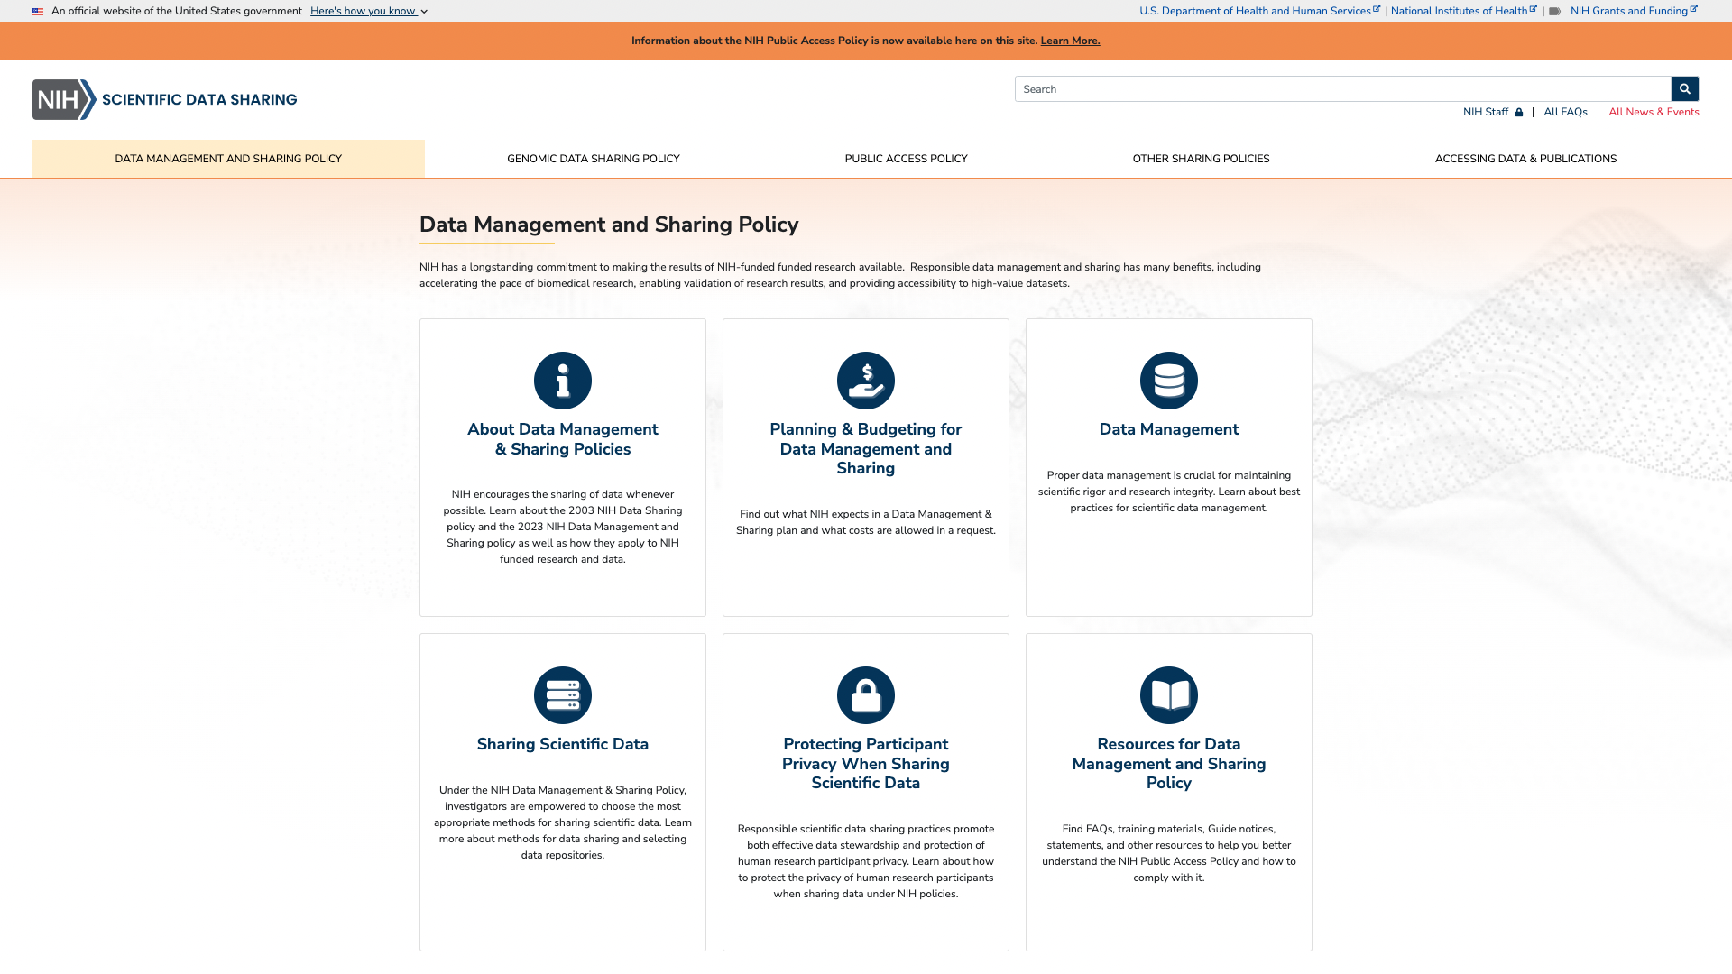
https://sharing.nih.gov/data-management-and-sharing-policy

Slide 18
https://sharing.nih.gov/data-management-and-sharing-policy/planning-and-budgeting-for-data-management-and-sharing/writing-a-data-management-and-sharing-plan#submitting-data-management-and-sharing-plans
https://research.uams.edu/research-resources/data-sharing-and-management/sample-data-management-plans/
Notes:
NIH has 26 examples

Slide 19
Lessons Learned
The Hard Way!

Slide 20
NIH is Confused
Most Institutes do NOT send DSMPs to reviewers
They are reviewed by program staff only
BUT they MUST BE INCLUDED, or your application will be rejected!
Most FOAs still require a Resource Sharing Plan
Some also require a Software Sharing Plan
They may also NOT be given to reviewers even when this is a Scorable Item!

Slide 21
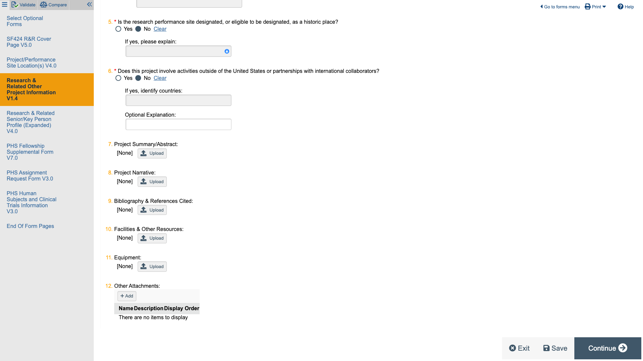
WARNING: Other Attachments
DMSPs and increasingly other required elements must be included in the Other Attachments area of the grant package.
Neither Muse nor NIH’s submission software can check this area for compliance so missing attachments DO NOT GENERATE ERRORS!
The SRO or Program Officer has to manually check for a complete package
We have had one grant rejected because of a missing Other Attachment!

Slide 22
Example of Required Other Attachments (RC2 FOA)
Applications that do not include one or more of these attachments will be considered incomplete and will not be reviewed.

Slide 23
UAMS Enforcement of DMSP
We had an application in final review almost rejected because we did not have an acceptable response (as far as the program officer was concerned) to Element 6: Oversight of Data Management and Sharing
Example Responses:
Andrea Ham, Senior Director of Research Sponsored Programs and Research Information Systems, is responsible for administering this award and providing NIH with documentation regarding compliance with the data management and sharing plan within the required NIH progress reports.
Compliance with this data management and sharing plan will be the responsibility of the PI.
Monitoring of and compliance with this Data Management and Sharing Plan will be the responsibility of the Principal Investigator. The plan will be implemented and managed by professional staff working under the direction of the PI.

Slide 29
In Summary
This is still an evolving process at NIH and likely to change.
BUT it is a requirement, and you Must take it seriously.
We have lots of examples to guide you and NIH provides training materials and templates.
The TRI Comprehensive Informatics Resource Core (CIRC) is available to help you.
HINT: a lot of the work involved in data management can and will be handled by existing cores.

Slide 30
Thank You

